Slide 1
Unlocking Images
Your All-in-One Image Captioning Platform
Team Members:
Deeksha Ailawadi [E22CSEU0444]
Sonalika Goel [E22CSEU0428]
Aashi Garg [E22CSEU0447]
Mentor Name:
Prof. Akansha Singh
Prof. Sonam Puri

Slide 2
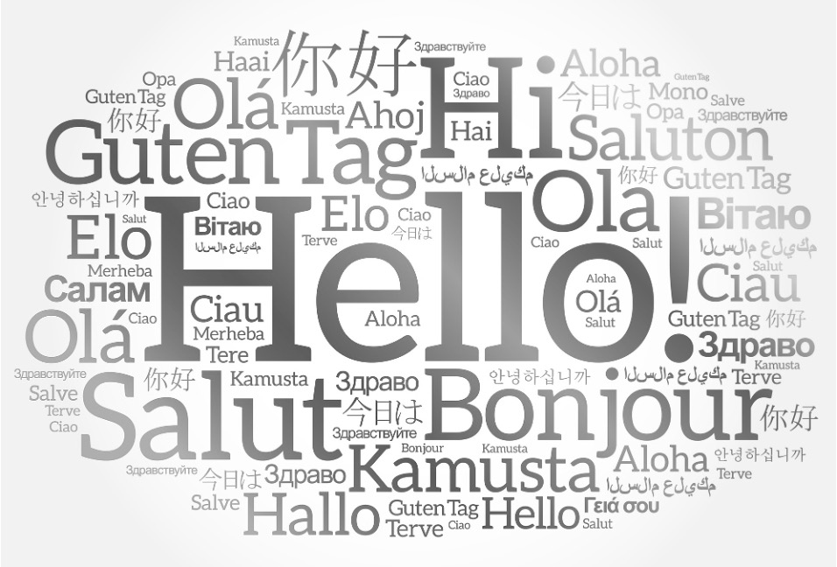
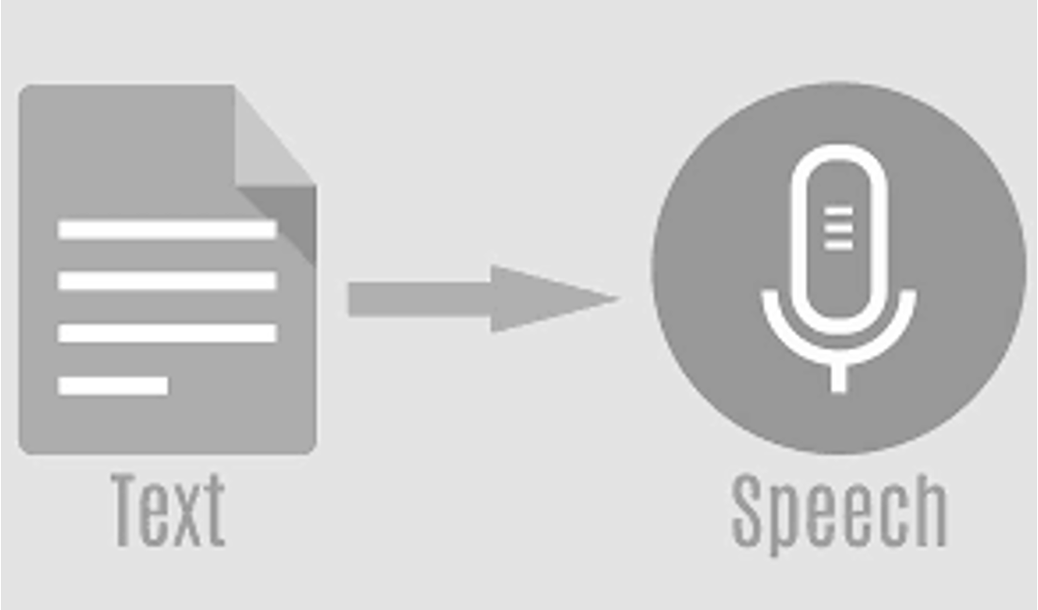
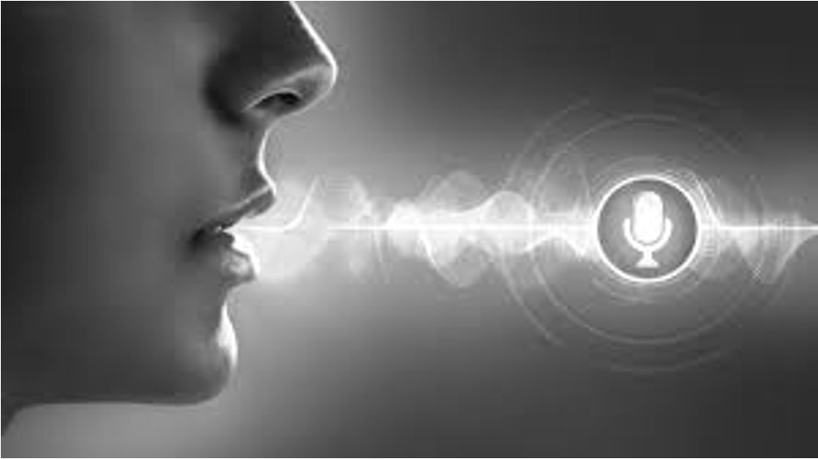
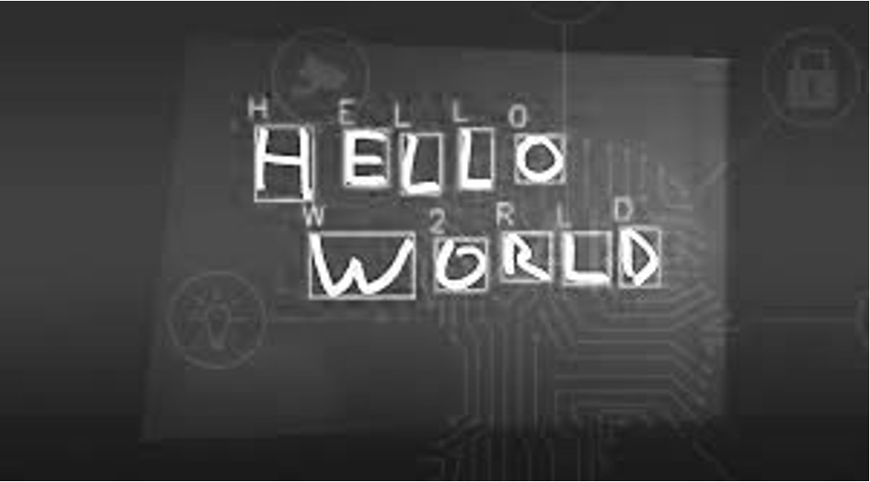




INTRODUCTION
Picture a society in which pictures communicate with you verbally and tell stories to you through handwritten words, text, and even voice. That's the idea behind the project, Unlocking Images, which aims to realize the full potential of image
comprehension and communication.
Unlocking Images is fundamentally an interactive online platform driven by state-of-the-art artificial intelligence that creates descriptions for images, translate captions into dozen of languages and, gives visual voice to your images.
Translates these captions into dozens of languages, making visual content accessible to a global audience. This multi-modal approach ensures that individuals from diverse linguistic backgrounds can understand and engage with visual content effectively.
Converting the generated text into the audio output for helping visually impaired people.
An image caption generation project can enhance the accessibility and user experience by converting the generated captions into spoken language.
Including a function to translate handwritten text in photos into machine-readable text.

Slide 3
Resources Required
Keras
Tensorflow GPU
Pre-trained VGG-16 weights
Numpy
Matplotlib
The dataset used here is the FLICKR8K which consists of around 8091 images along with 5 captions for each image.
FLICKR30K which has around 30,000 images with captions.
Dependencies
Dataset
The hardware setup should include at least one high-performance GPU. The GPU should support TensorFlow and have sufficient memory to accommodate the project's deep-learning models.
Source code management software
Effective teamwork is facilitated by using collaboration tools like Git for version control and GitHub or GitLab for code hosting.
Hardware

Slide 4
Working of the Model
The generated caption is presented to the user.
Using the extracted features, the model generates a textual caption that describes the image.
The model takes an image as input uploaded by the user.
The model then analyses the image and extracts features such as objects, colours, scenes, and activities.

Slide 5
Success Measurement
Technical
30%
Accuracy & completeness of core features like image descriptions, translations, and voice narration.
Usability & Accessibility
30%
User testing with diverse groups, expert evaluation, and adherence to accessibility standards.
Impact & Potential
20%
User engagement, perceived value, and roadmap for future development.
Teamwork & Communication
20%
Project management, collaboration, learning, and knowledge sharing.

Slide 6
Problem Addressed
The "Unlocking Images" initiative addresses important questions about technology potential, accessibility, and communication. For someone who cannot see, understanding the content of an image can be impossible without human assistance. Our project, automatically generates textual descriptions, allowing individuals to "hear" what's in the image through text-to-speech software or other assistive technologies. This opens up a whole world of visual information. By describing images posted on social media platforms, caption generators can allow visually impaired individuals to participate in online conversations and understand visual references shared by others. This fosters social inclusion and connection. However, the potential benefits for visually impaired individuals are undeniable. As technology advances and these challenges are addressed, image caption generators promise to play an increasingly important role in creating a more inclusive and accessible world for everyone.

Slide 7

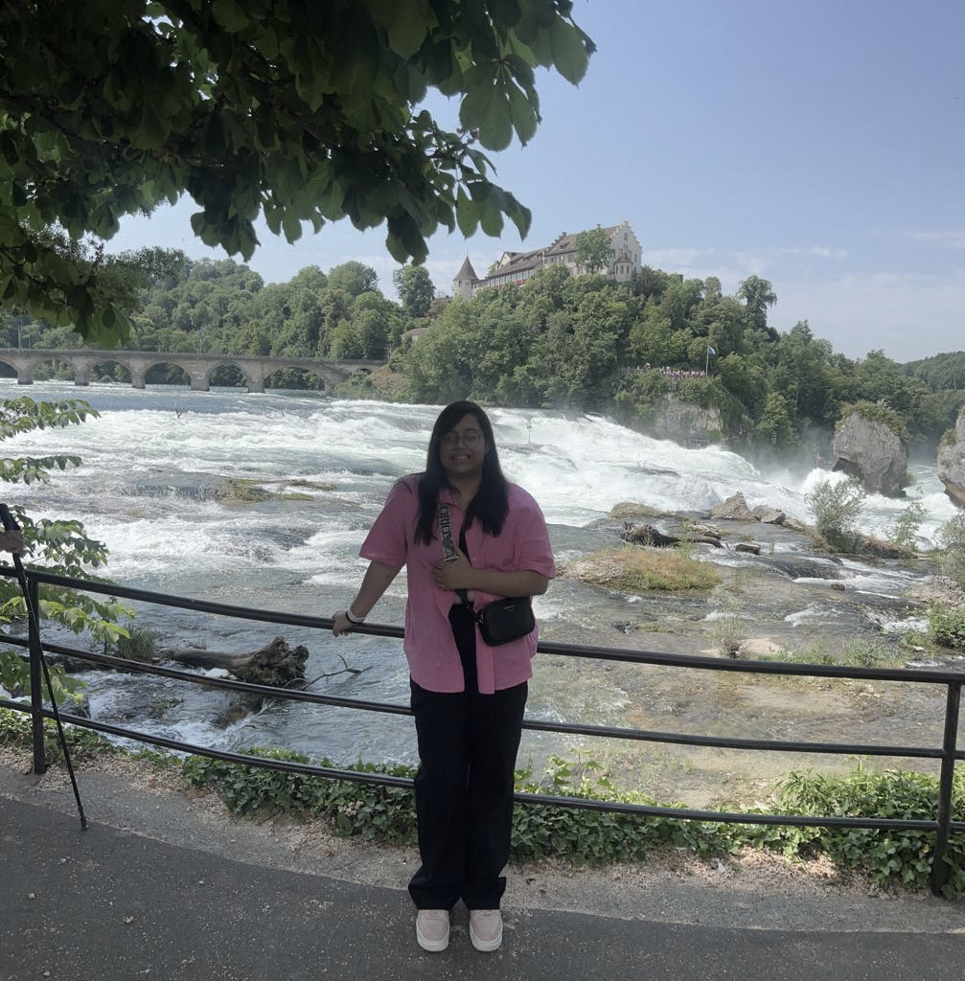
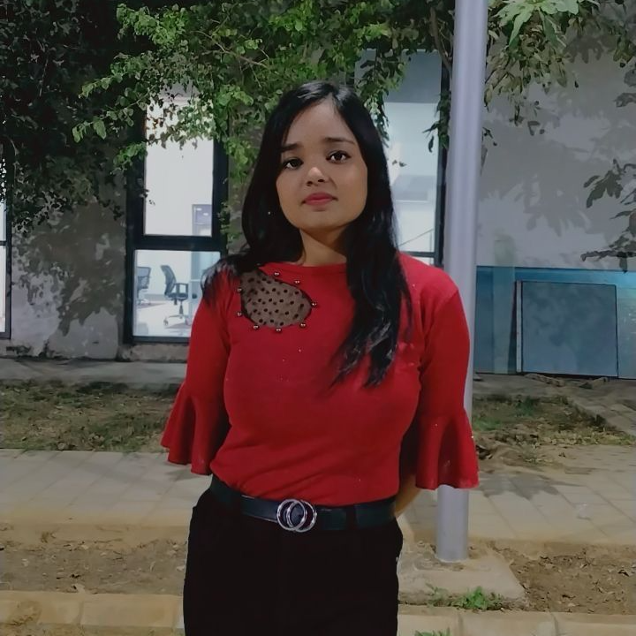
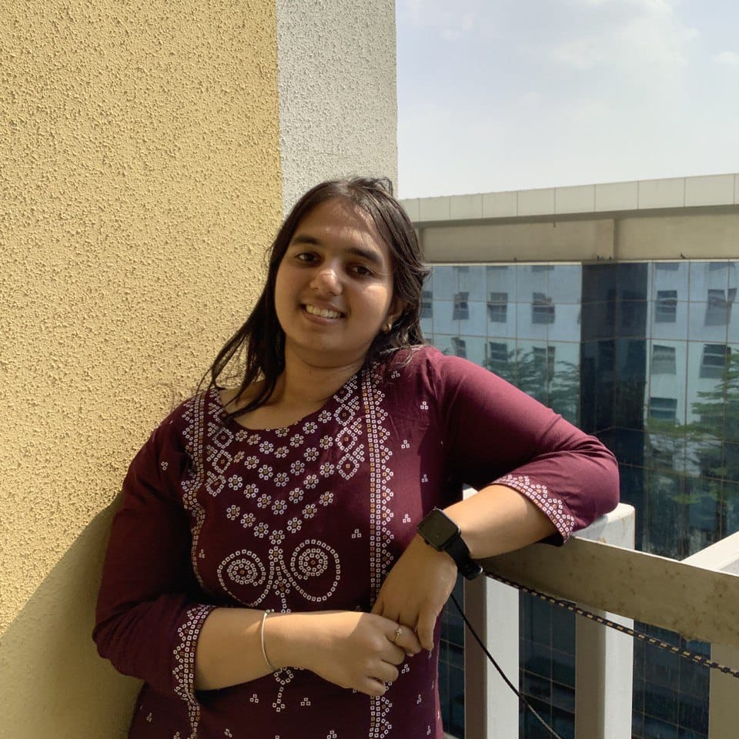
Individual contribution
Oversees the entire AI pipeline, which includes acquiring data, creating models, training them, and evaluating them. Works closely on AI techniques for image comprehension, caption generation, translation, and text-to-speech. Establishes performance metrics and benchmarks for AI models, ensuring accuracy, fluency, and efficiency.
Design and implement the AI model for image analysis and caption generation and Image datasets have been processed and are prepared for training.
The tasks include developing and optimising the algorithm for processing images and incorporating natural language processing to generate captions.
Creates the user interface (UI) of the platform that is user-friendly and easily accessible and makes sure it speaks to the AI capabilities in an intuitive yet easily approachable manner. Processes usability testing and receives user response to later evaluate and modify the UI/UX designs in a way that will find acceptance and bring satisfaction to the user
Deeksha Ailawadi
E22CSEU0444
Sonalika Goel
E22CSEU0428
Aashi Garg
E22CSEU0447

Slide 8
Short and Long-term
planning

Slide 9
Short and Long-term
planning
01 January–February
During the first two months of the project (January–February), the team will concentrate on developing a working prototype of the "Unlocking Images"
02 March- April
The team will continue to improve and add features to the platform as we enter the third and fourth months
03 After the first four months
The team's main goal will be to scale and enhance the "Unlocking Images" project.

Slide 10
Potential clients

Slide 11
The software can help people who have trouble reading traditional books by creating thorough text descriptions for the photos. The platform guarantees excellent access to and comprehension of visual information for those with reading impairments by offering extensive captions and translations. An additional benefit is the text-to-speech feature, which enables users to hear the generated descriptions rather than just read them. This aural way of interaction offers a different and inclusive approach, meeting the needs of individuals who might find it difficult to use traditional reading methods and supporting a variety of learning styles. Beyond just catering to those with visual impairments, the initiative aims to create an environment where people with a range of accessibility needs—including those who struggle with reading—can interact and comprehend visual information more easily.
‘
People with Reading Difficulties

Slide 12
This feature facilitates cross-cultural communication by removing language barriers and catering to the linguistic diversity of the global audience. This feature enables multilingual users to interact with visual material and view image captions in their native tongue, promoting a more diverse and international experience. This feature of the platform can be used by educational institutions, museums, and galleries to provide content in several languages, making their resources available to a wider audience. The project's dedication to catering to a multilingual audience is in line with the objective of fostering greater interconnectedness so that people with disparate linguistic backgrounds may converse and comprehend visual narratives with ease.
Multilingual Audience

Slide 13
The "Unlocking Images" project's addition of text-to-speech capability improves its influence on the lives of people with visual impairments even more. With this capability, the platform produces text descriptions for photos and audio output from this content. Because it enables people with visual impairments to receive image descriptions and translations through spoken words, this function especially benefits them.
Now, visually impaired people may enjoy an immersive and inclusive experience by listening to full descriptions of images and reading them. With the help of this feature, online content, educational resources, and cultural materials might all become much more accessible, allowing people with visual impairments to interact with information and stories in ways that best suit their needs and tastes.
Visually Impaired People

Slide 14
Thank
you

